Slide 1
SURVIVAL PLOTS FOR SURVEY
VR

Slide 2
BACKGROUND
Time-to-event analysis “survival analysis” is a key area of statistics that has several applications in clinical practice, for instance, in the management of Noncommunicable diseases, to understand survival time, time to recurrence, or relapse.
This survey aims to understand clinicians’ preferences in visualizing survival data.
There will be 3 types of survival plots: Kaplan Meier, survival ratio, and survival difference plots. The same data is displayed differently. We would like to know your preference among the 3 plots. Interpretations will be provided.
This study is conducted by Victor and Shyam in fulfillment of an MSc in health data science at the University of Galway.
All the responses are anonymous and Participation is voluntary. It will take 5 min
Your input is highly valued, and we appreciate your time in completing this survey.
For more information: v.rwandarwacu1@universityofgalway

Slide 3
DATASET DESCRIPTION
The TCGA BRCA (The Cancer Genome Atlas Breast Invasive Carcinoma) is a publicly available resource,
The clinical dataset provides comprehensive patient-level clinical information to support breast cancer research. It includes key variables such as demographics, tumor characteristics (pathologic TNM staging, histologic type, hormone receptor status), treatment details, survival outcomes, and recurrence status.
This dataset enables the analysis of prognostic factors, survival patterns, and treatment responses, making it a valuable resource for understanding clinical outcomes in breast cancer.

Slide 4
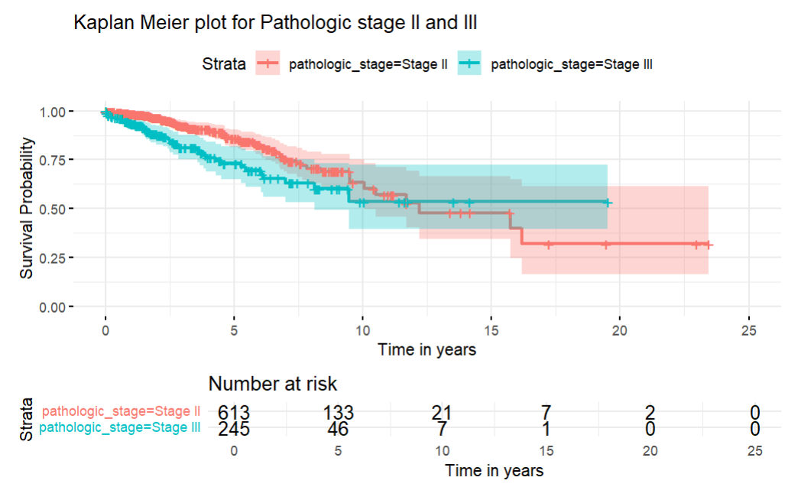
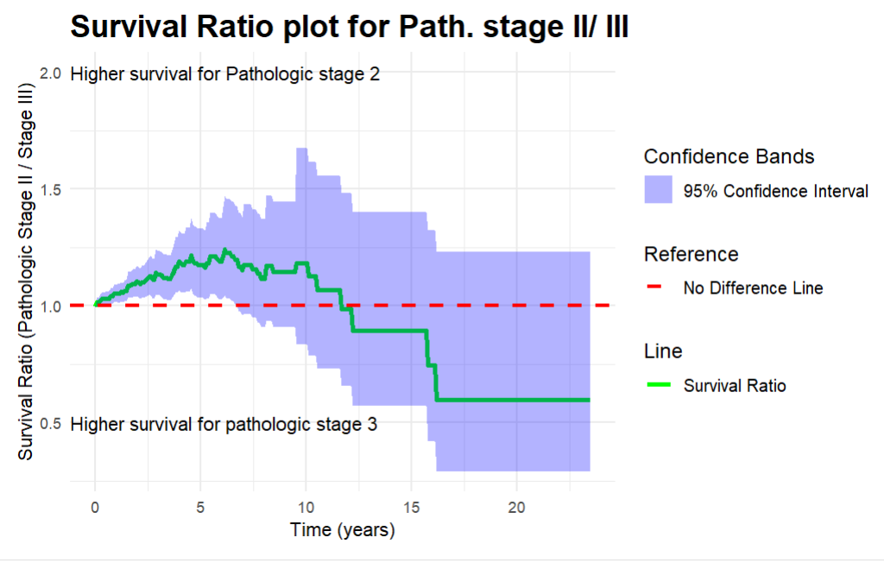
Comparison of survival between Pathologic stage II and III

Slide 5
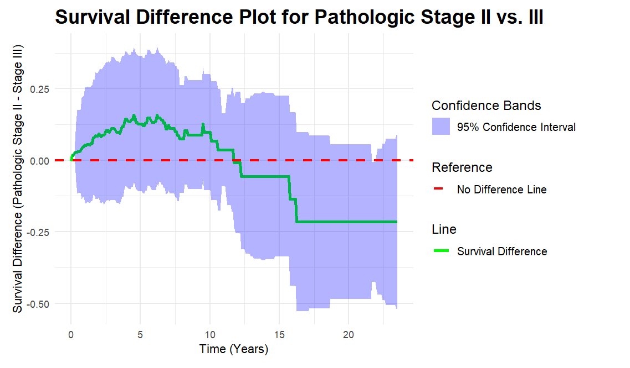
Comparison of survival between Pathologic stage II and III
ANSWERS

Slide 6
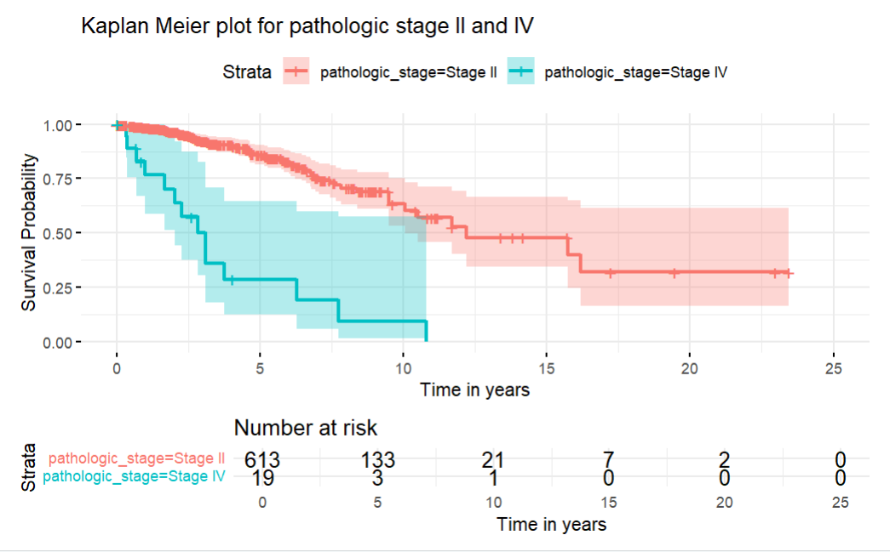
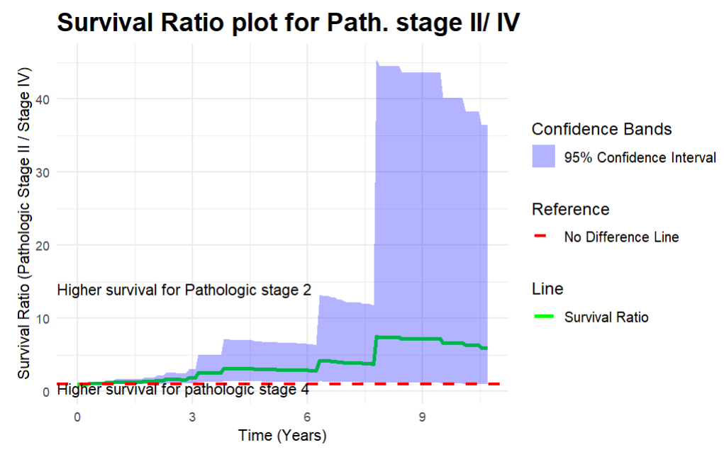
Comparison of survival between Pathologic stage II and IV

Slide 7
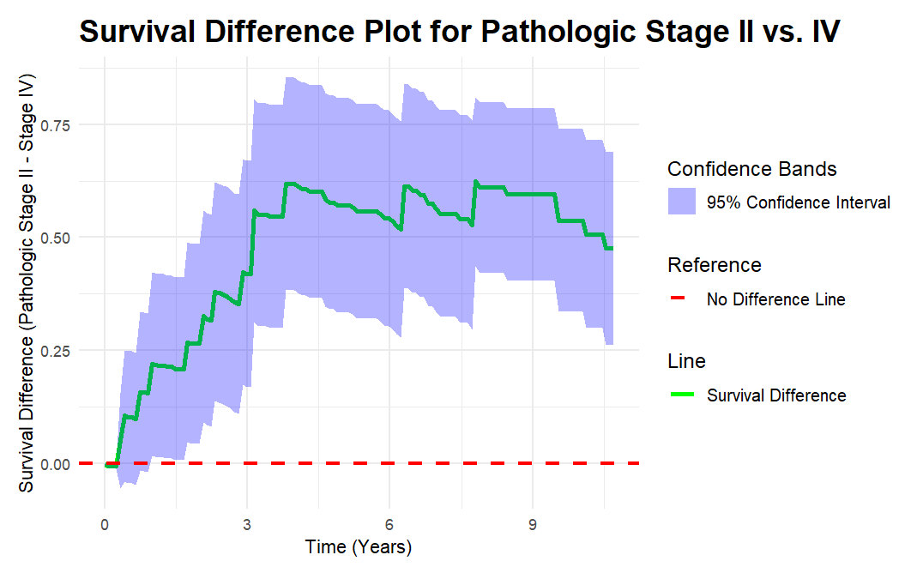

Slide 8
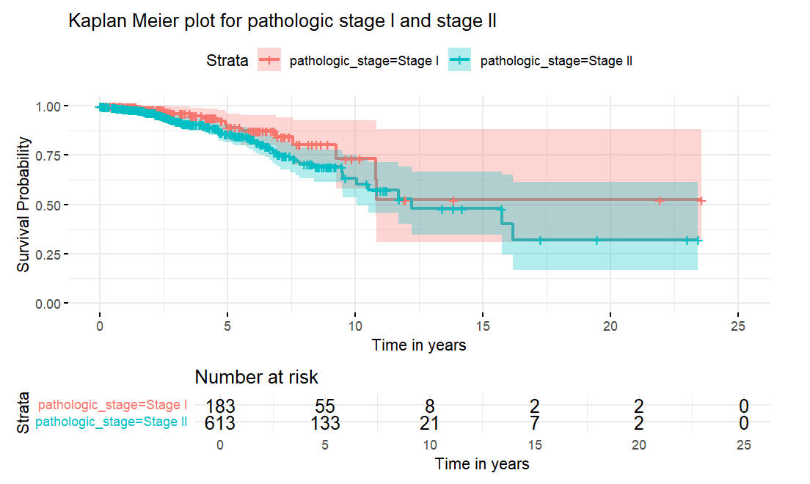
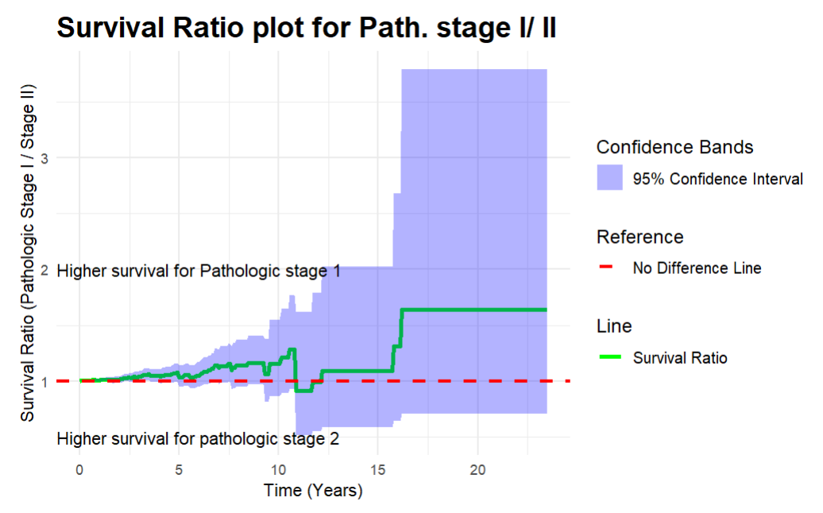
Comparison of survival between Pathologic stage I and II

Slide 9
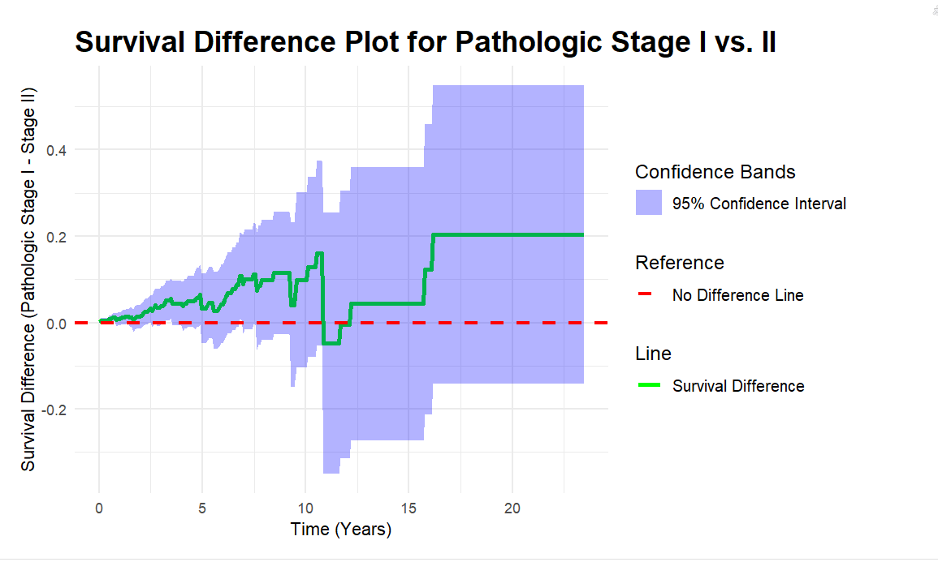
Comparison of survival between Pathologic stage I and II

Slide 10
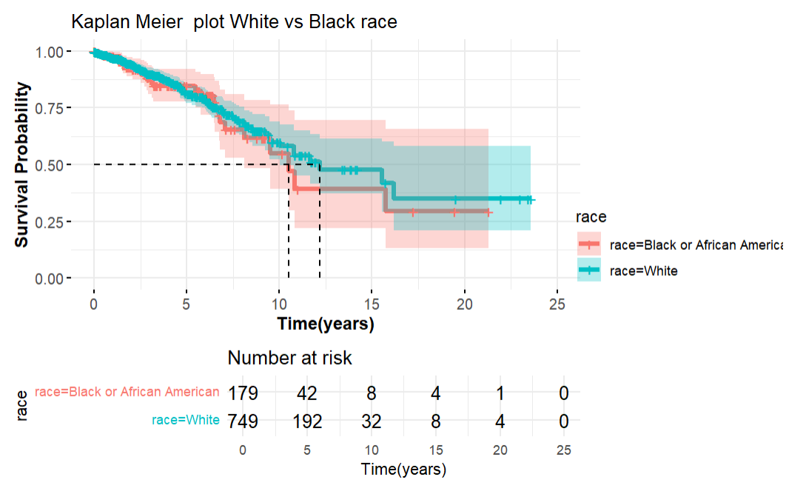
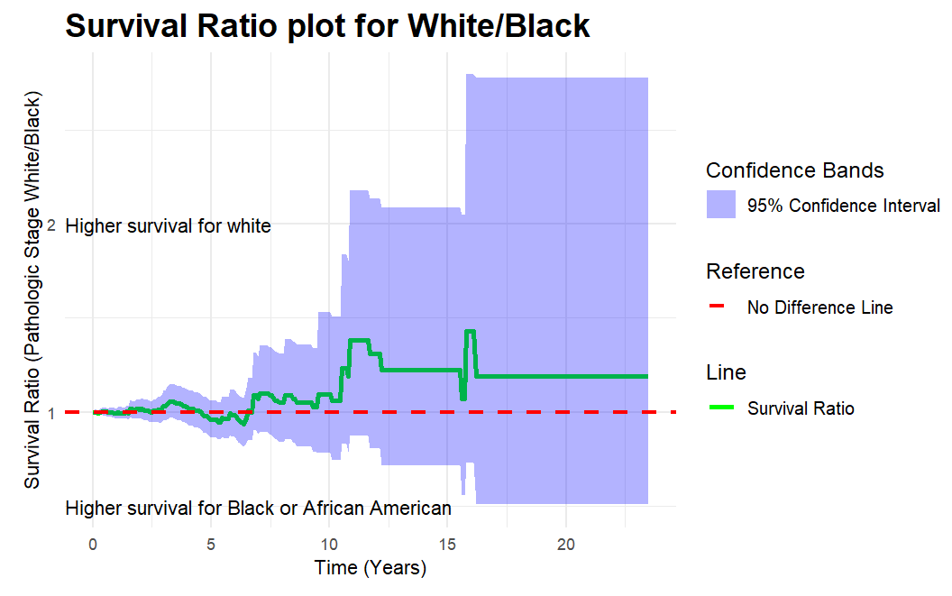
Comparison of Survival White versus Race

Slide 11
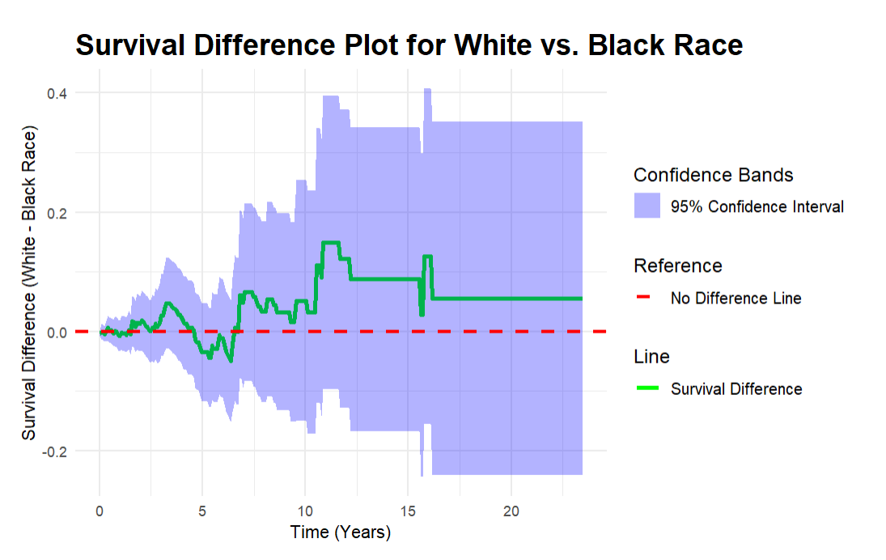

Slide 12
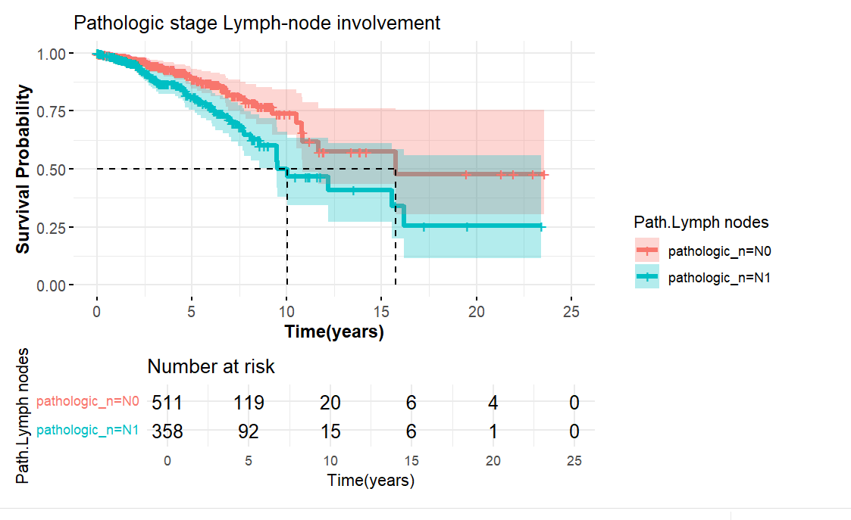
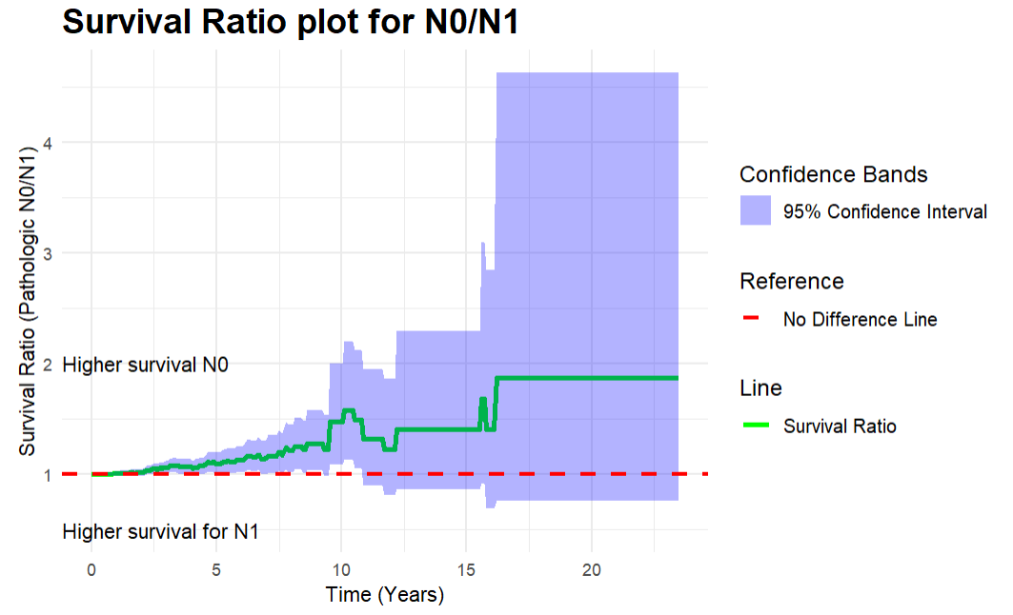
TNM N0/N1

Slide 13
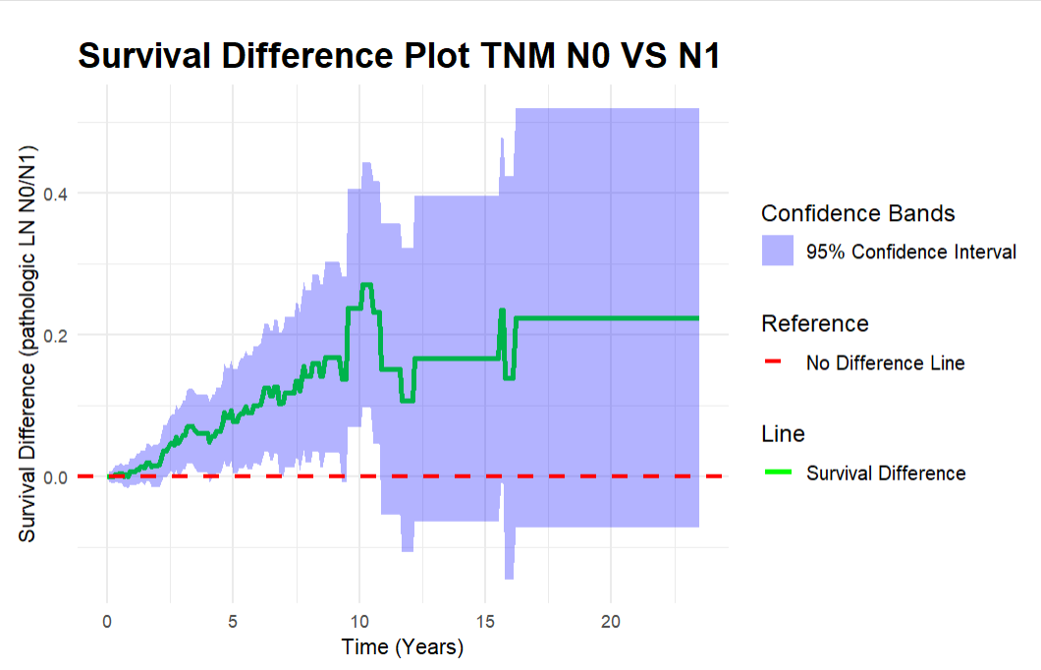
TNM(N0/N1)

Slide 14
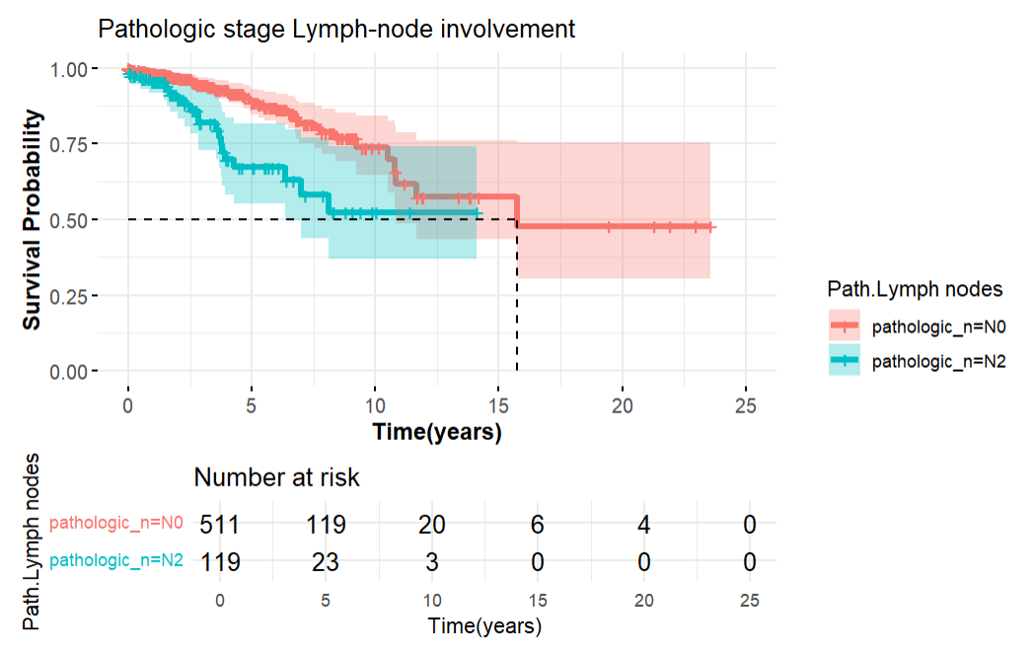
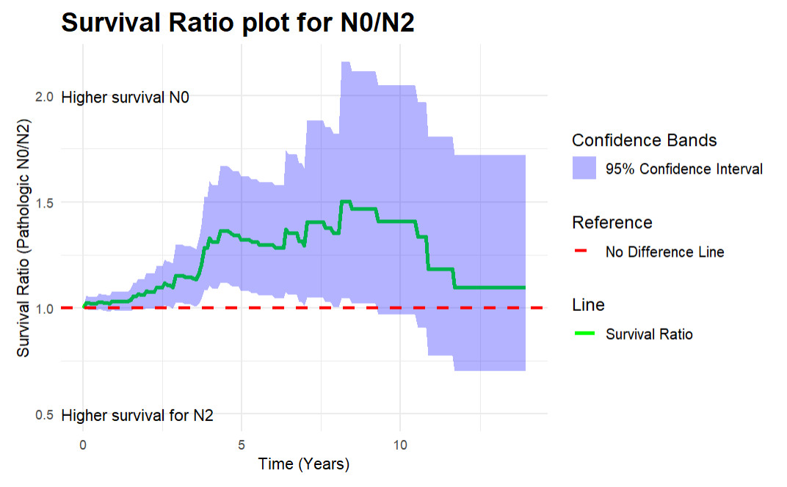
TNM(N0/N2)

Slide 15
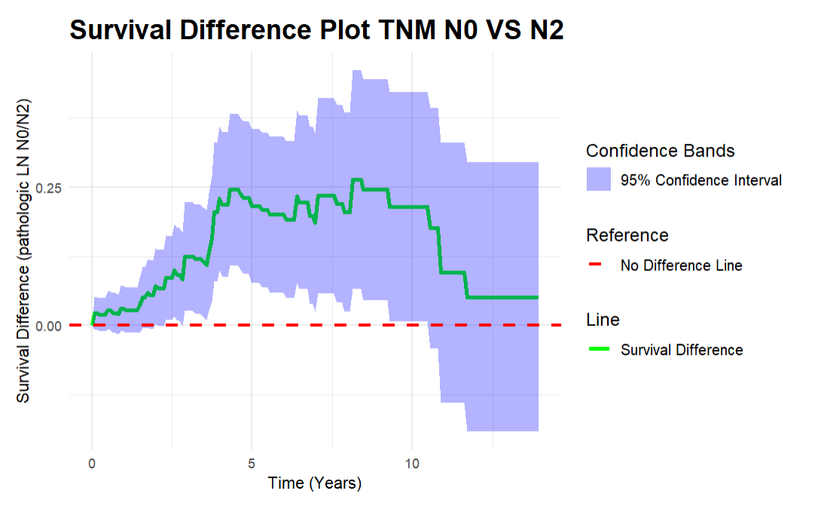
TNM (N0/N2)

